Slide 1

Personal and Personalized Learning
Stephen Downes
April 16, 2016

Slide 2

The Inflexible Law of Learning
It's when we do stuff that we learn, not when stuff does something for us.

Slide 3
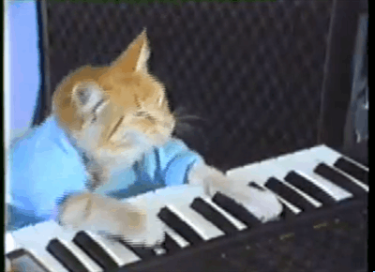
1. Learning is Personal

Slide 4
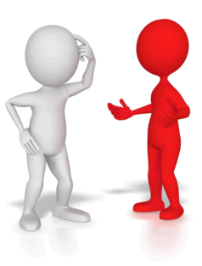
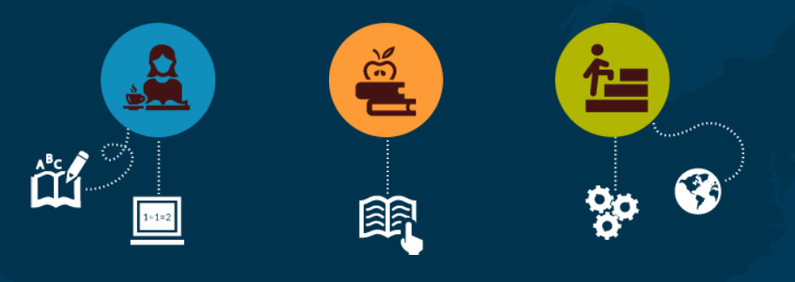
Standardized Learning
The Standards’ refers to all elements of the design – the wording of domain headings, cluster headings, and individual statements… The pieces are designed to fit together, and the standards document fits them together…
Publishers’ Criteria for the Common Core State Standards for Mathematics (July 2012) https://ldc.org/sites/default/files/mctighe_wiggins_final_common_core_standards_0.pdf

Slide 5

Knowledge Translation
“…defined as a dynamic and iterative process that includes synthesis, dissemination, exchange and ethically-sound application of knowledge ....”
CIHR, http://www.cihr-irsc.gc.ca/e/39033.html
Campbell Collaboration - knowledge base for decisions
http://www.campbellcollaboration.org

Slide 6
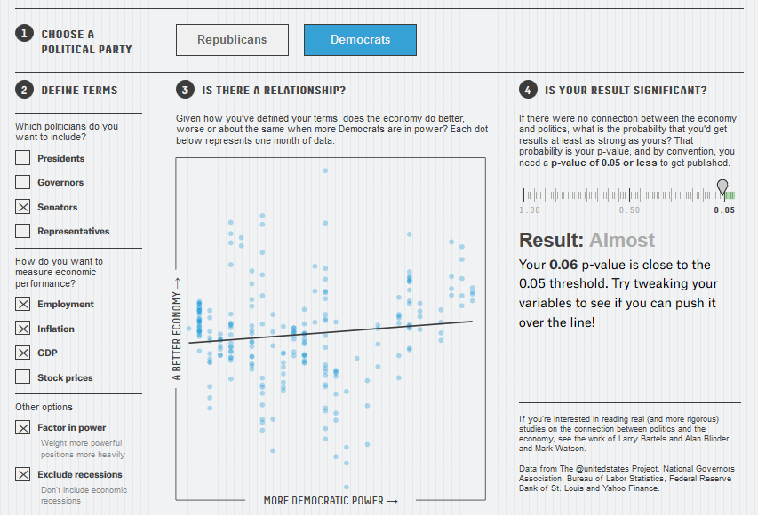
Reasonable Doubts
The crisis can't be wished away, nor can the basic lack of reproducibility be whitewashed.
http://www.downes.ca/post/65131
http://fivethirtyeight.com/features/science-isnt-broken/#part2

Slide 7
Criticisms…
“research should move beyond a narrow focus on the ‘know–do gap’ to cover a richer agenda…”
  situation-specific practical wisdom (phronesis)
  tacit knowledge shared among practitioners (‘mindlines’)
  complex links between power and knowledge; and
  macro-level knowledge partnerships
Greenhalgh and Weiringa, http://jrs.sagepub.com/content/104/12/501.full

Slide 8
Personalization?
What is a personalized 21st century education
- personalized education plan (developed by teacher)
- adaptive learning via assessment
- grouping by proficiency, not age
- teacher = director of learning
- cf Kettering Foundation, Individually Guided Education
Personalizing 21st Century Education: A Framework for Student Success
Dan Domenech, Morton Sherman, John L. Brown
Jossey-Bass, a Wiley Brand. 2016

Slide 9
2. Two Approaches…
Content
Practice
Practice
Content

Slide 10
Two Approaches…
Defines an ideal state
Defines a desired state
Content
Practice
Practice
Content
TEST
TRY
Person tests you
Person helps you

Slide 11
Two Approaches…
Defines an ideal state
Defines a desired state
Content
Practice
Correction
Iteration
GAP
Practice
Content
Opport-unity
TEST
TRY
Person tests you
Person helps you

Slide 12
Library Environment
Defines an ideal state
Defines a desired state
Content
Practice
Affordances
Correction
Requirements
Iteration
GAP
Practice
Content
Opport-unity
TEST
TRY
Person tests you
Person helps you

Slide 13
Personalized Personal
We do for you You do for yourself
Defines an ideal state
Defines a desired state
Content
Practice
Affordances
Correction
Requirements
Iteration
GAP
Practice
Content
Opport-unity
TEST
TRY
Person tests you
Person helps you

Slide 14
Personal vs. Personalized
Compare between:
  Personalized health care (something the National Health Service or Health Management Organization provides)
  Personal health care (something you do for yourself)
Personal goals versus institutional goals
Practice versus content

Slide 15
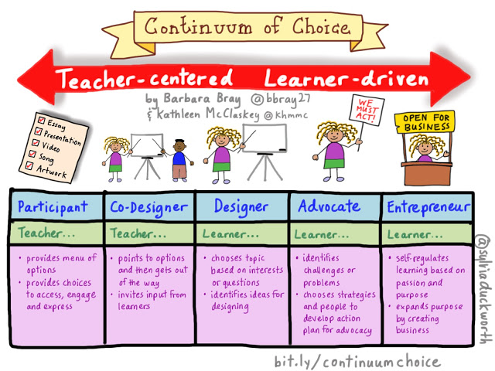
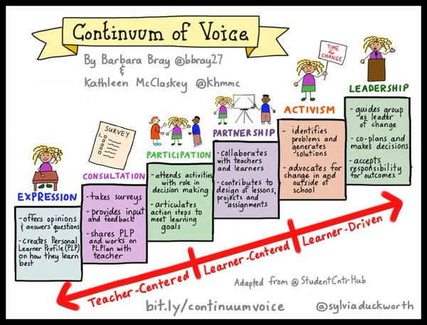
Voice and Choice
Barbara Bray and Kathleen McClaskey
Shared by Denisha Read

Slide 16
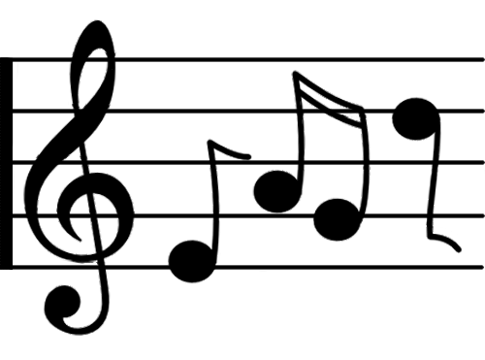

3. Learning Through Practice

Slide 17
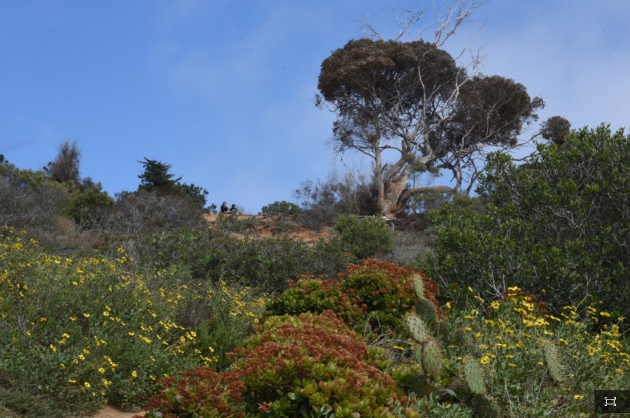
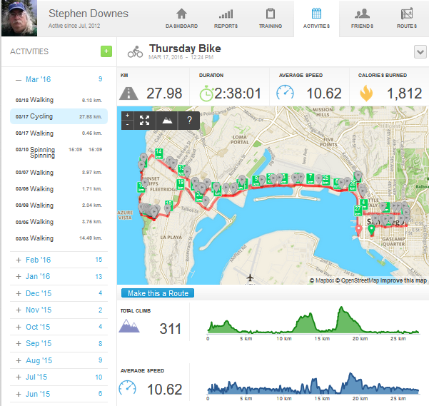
Exploring, not Following

Slide 18
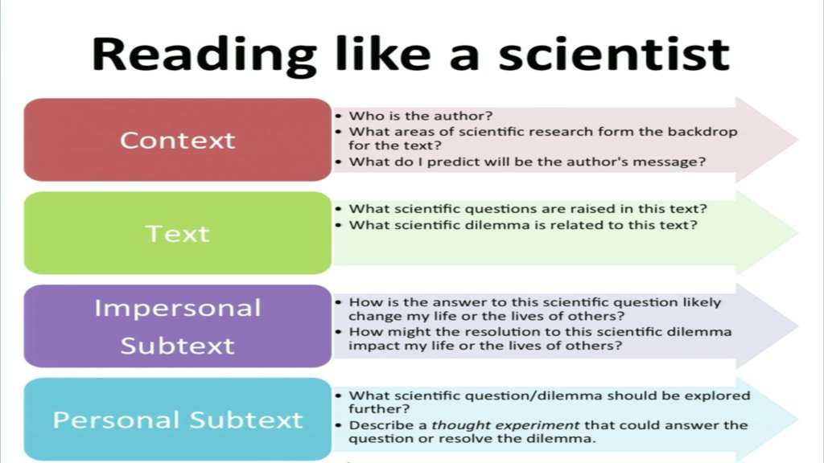
Reading Like a Scientist
Cf Cindy Moss.

Slide 19
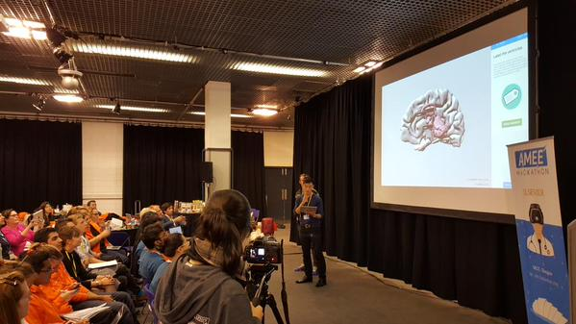
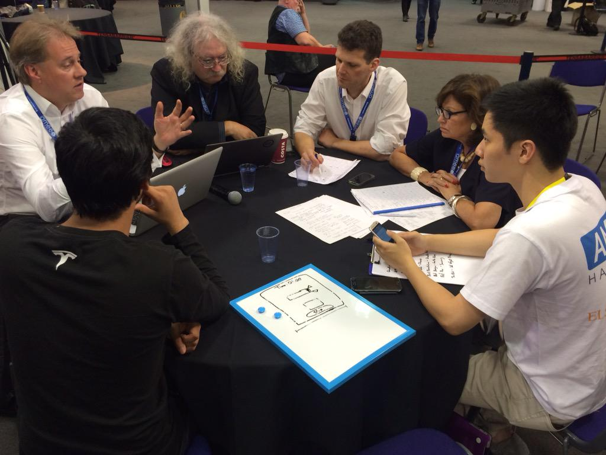
The Hackathon…
http://www.hackathon.io/events

Slide 20
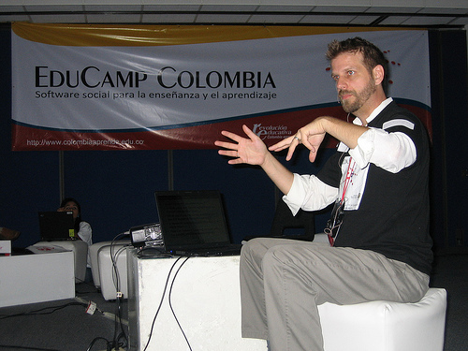
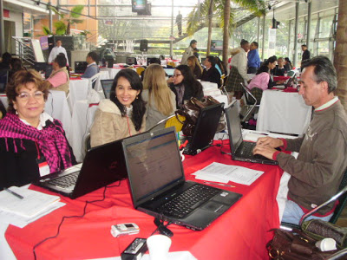
The EduCamp
http://www.flickriver.com/photos/qadmon/3106848811/
http://www.irrodl.org/index.php/irrodl/article/view/884/1677
http://pertinenciaeducativa09.blogspot.ca/2009/10/educamp-colombia-aprendizaje-en-un.html

Slide 21
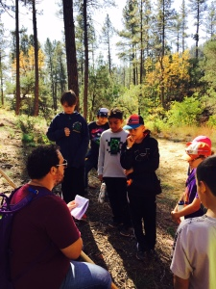
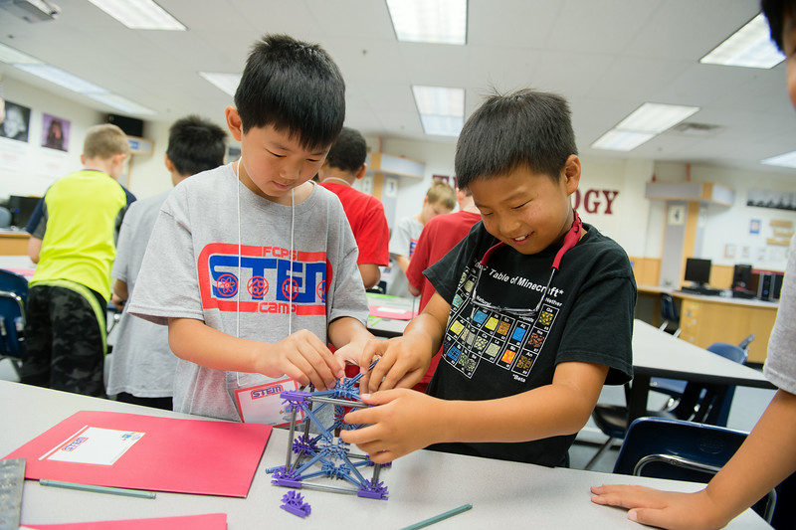

STEM Camp
Via Cindy Moss
http://www.discoveryeducation.com/STEM/connect-the-dots.cfm

Slide 22
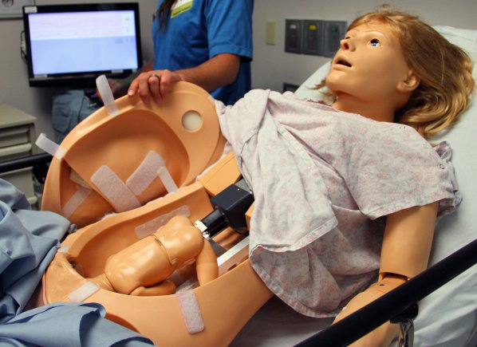
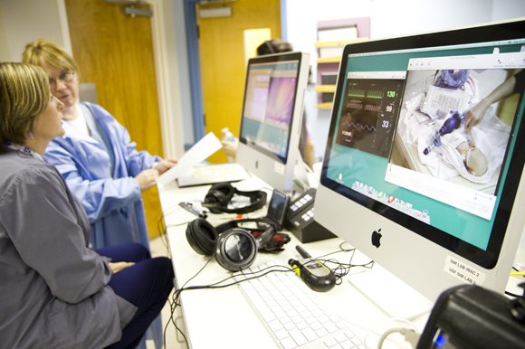
Medical Simulations
http://www.army.mil/article/127148/
http://www.83degreesmedia.com/features/camls011012.aspx

Slide 23

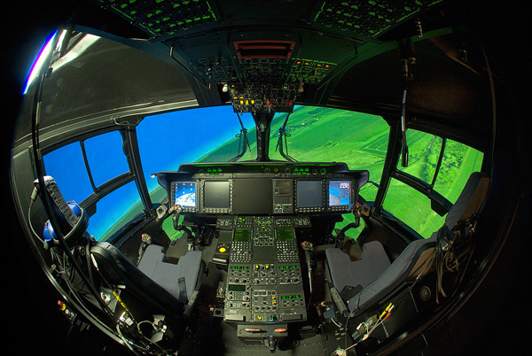
Flight Simulators
http://www.cae.com/World-s-first-AW189-full-flight-simulator-ready-for-training/
http://www.aiac.ca/canada-aerospace-industry/success-stories/cae-nh90-helicopter-simulator/
http://www.aiac.ca/canada-aerospace-industry/success-stories/cae-nh90-helicopter-simulator/

Slide 24
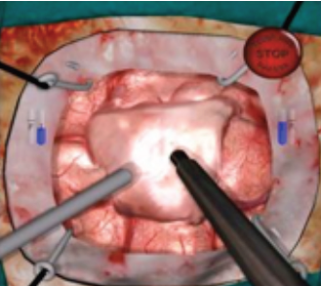
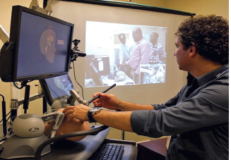
NeuroTouch Simulator

Slide 25
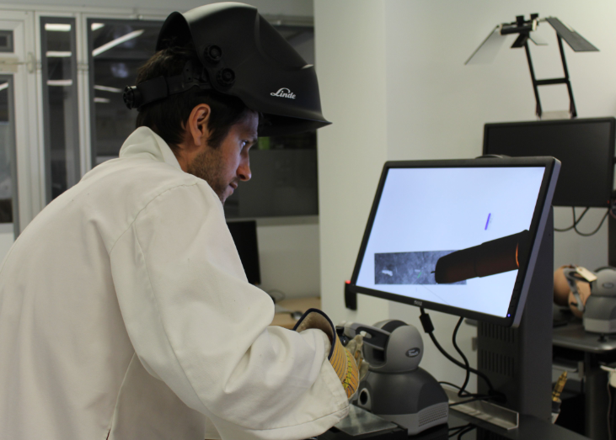

Sim-Welding

Slide 26
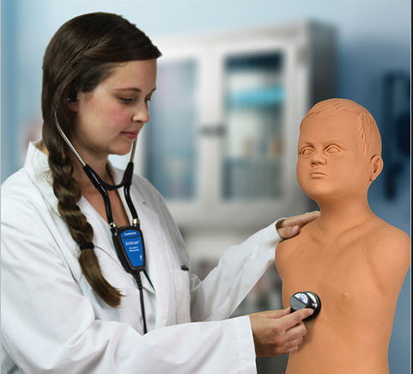
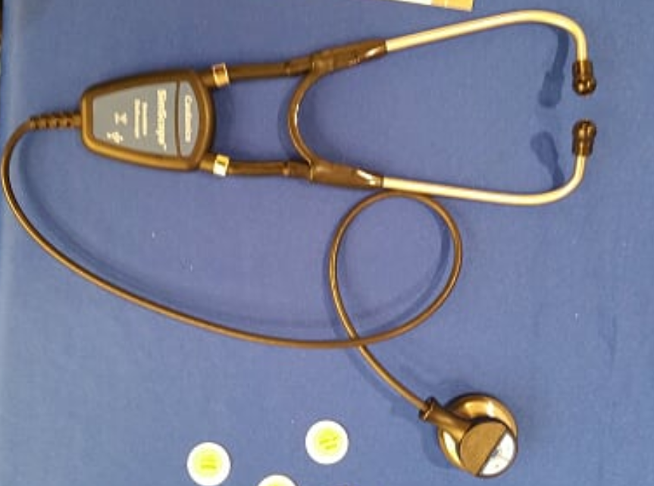
Auscultation
http://www.cardionics.com

Slide 27

4. Learning Communities - the cMOOC

Slide 28

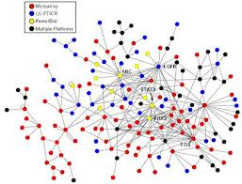
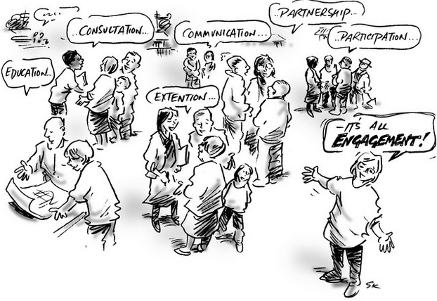

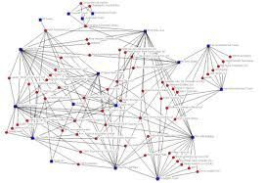
xLearning vs cLearning
contents
engagement
networks
http://www.corestandards.org/
http://www.magnet.edu/
http://lisahistory.net/wordpress/2012/08/three-kinds-of-moocs/

Slide 29
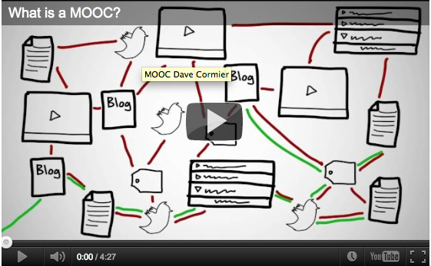
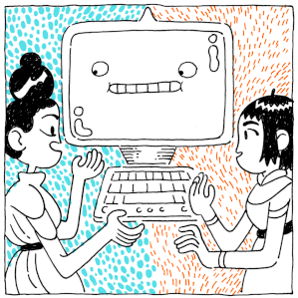
How to Learn in a cMOOC
Learning is a process of immersion into a knowing community
http://www.tonybates.ca/2012/03/03/more-reflections-on-moocs-and-mitx/

Slide 30
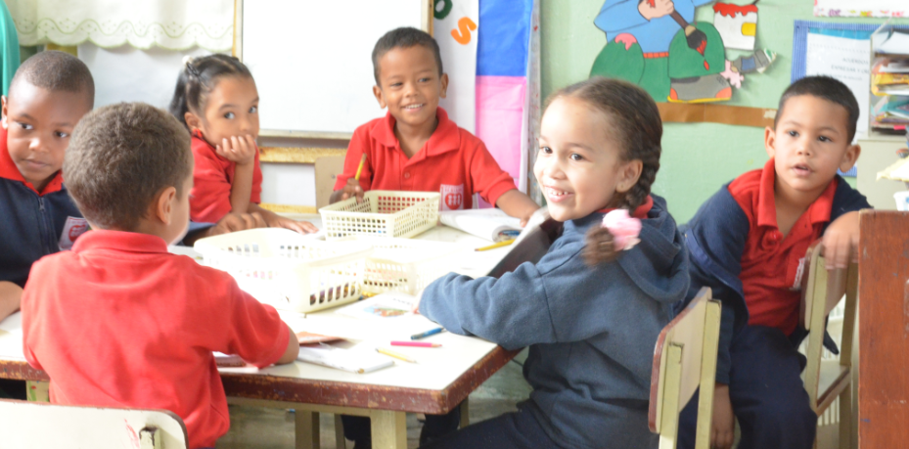
MOOC Design
Course structure – a series of topics
  The instructors will not ‘teach’ the topics, they ‘investigate’ or ‘work through’ the topics (model and demonstrate)

Slide 31
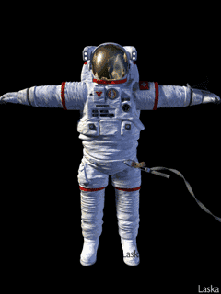
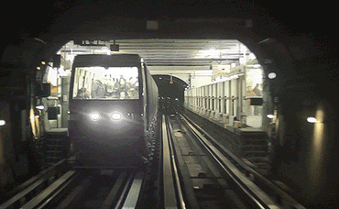
A Focus on Exploration

Slide 32
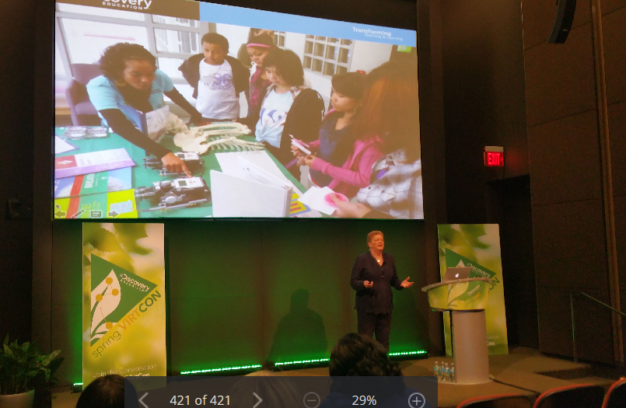
Cindy Moss: STEM is a Culture

Slide 33
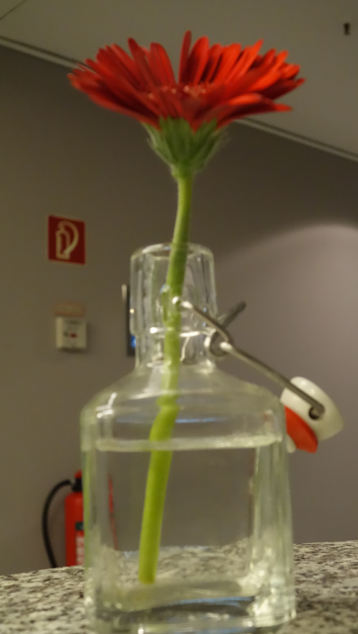
Learning is a form of recognition
It’s what we do naturally, as humans, from the day we are born
And it’s something that grows and evolves into a complex set of basic literacies, including pattern recognition, critical thinking, action and behaviour, awareness of context, inference and imagination, and change (the ‘critical literacies’)
http://halfanhour.blogspot.de/2014/11/knowledge-as-recognition.html

Slide 34

It is essential to immerse oneself in the day-to-day activities and culture of the people who speak it.
Image: http://www.tumblr.com/tagged/tumblr%20language
Notes:
It is, indeed, like the learning of a language. It is possible to learn a language in theory, by studying books, as though one would study Latin. But to learn a language fully it is essential to immerse oneself in the day-to-day activities and culture of the people who speak it.
Again, it is tempting to say that there are certain things that people learn when they learn a language, that there is some content that is essential to being a speaker of that language. The meaning of words, for example, or the conjugation of verbs. But this is misleading and wrong.
Dictionary meanings and verb conjugations are, at the very best, an abstraction of the much more complex set of practices, attitudes and beliefs common among physicists. Because it is an abstraction, such a description cannot be accurate, and may actually mislead people about what being a physicist actually entails.
A person who merely knew the content supposedly taught and tested for at a language academy would feel grossly out of place in a gathering of physicists. It's like knowing the words but not knowing the tune.
So what a connectivist course becomes is a community of educators attempting to learn how it is that they learn, with the objective of allowing them to be able to help other people learn. We are all educators, or at least, learning to be educators, creating and promoting the (connective) practice of education by actually practicing it.
In practice connectivist teaching and learning consists of four major sorts of activities (and remember, this is just an abstraction, not a definition; just a starting point, and not 'content' to be remembered):

Slide 35
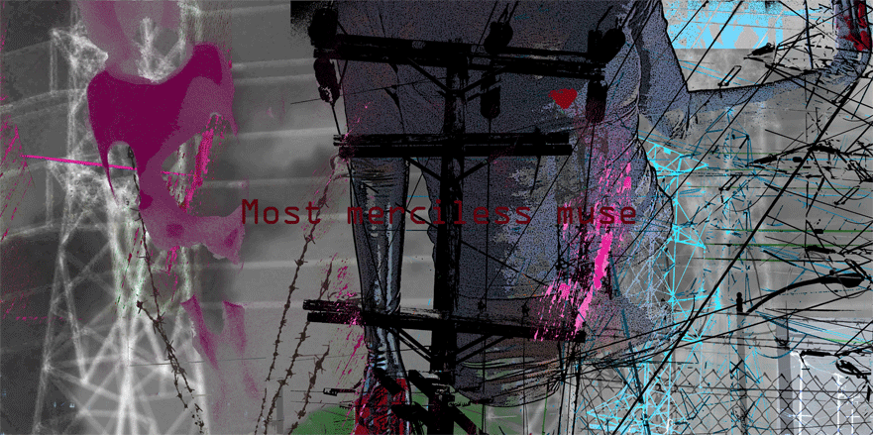
Each person creates their own perspective on the material by selecting what seems important to them.
Aggregation
Image: http://melindarsmith.com/most-merciless-muse
Notes:
Aggregation - the point of offering a course at all is to provide a starting point, to provide a variety of things to read, watch or play with. There is a lot of content associated with the course, everything from relatively basic instruction to arguments and discussions to high-level interviews with experts in the field.
The course is composed not only of recommended readings but also articles, videos and recordings made by course facilitators, blog posts, images, videos and other recordings made by course participants, collected tweets from Twitter, bookmarks from Delicious, discussion posts, and whatever else we can think of.
What we have experienced after delivering a half-dozen MOOCs is that we have to tell people at the start of the course to pick and choose what they will read, watch or participate in. Again and again, we have to stress that there is no central content to the course, that each person creates their own perspective on the material by selecting what seems important to them.
Again, if we draw the comparison to learning a language, it is like telling a person to pick and choose from real books, real newspaper articles, and real conversations.
From the perspective of the course provider, what is important at this point is that there actually be a rich range of resources, open and freely accessible, that can be used by course participants. In any course, in any discipline, I am looking for a wide range of resources, and encouraging course participants to do the same.
The key here is diversity. This includes diversity of format: we want texts, videos, animations, games, seminars, and anything else, because people prefer to use different media. But it also includes different languages and perspectives. In any MOOC – and not simply MOOCs designated as French-language, it would be relevant to include French-language resources.
One of the things I have learned in learning more than one language is that each language views the world differently, represents the world differently.

Slide 36
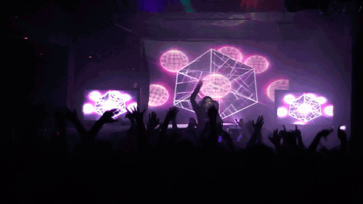
What we are encouraging here especially is a mixing of diverse cultures.
Remixing
Image: http://alodj.com/viet-remix-hay-khoc-di-em-remix-2013-s195.html
Notes:
Remixing - the next step is to draw connections. The idea is to associate the materials (or parts of the materials) with each other, and with materials from elsewhere.
There are different ways to associate materials -- typically we look for some sort of commonality, such as a term, reference, topic or category. Sometimes we look for a fit, as though one thing follows from another. There are no rules to association, and part of learning is to get a feel for what goes with what.
The main point here is to encourage people to keep track of this. We suggest that they keep records on their computers of all the documents they've accessed, perhaps with summaries or evaluations of the material. Or, better yet, they can keep a record online somewhere. That way they will be able to share their content with other people.
In the course we make some specific suggestions:
- Create a blog with Blogger. Go to http://www.blogger.com and create a new blog. Or, if you already have a blog, you can use your existing blog. You can also use Wordpress (http://www.wordpress.com) or any other blogging service. Each time you access some content, create a blog post.
- Create an account with del.icio.us and create a new entry for each piece of content you access.
- Take part in an online discussion. You can, for example, join a Google group and exchange thoughts with other course participants, or use the discussion forum provided in the course's online environment.
- Tweet about the item in Twitter. If you have a Twitter account, post something about the content you've accessed.
- Anything else: you can use any other service on the internet -- Flickr, Second Life, Yahoo Groups, Facebook, YouTube, anything! Use your existing accounts if you want or create a new one especially for this course. The choice is completely yours.
What we are encouraging here especially is a mixing of diverse cultures. We are not trying to create a blend, but to highlight the distinctive perspective offered by each. You can see here that an ideal MOOC requires participation from different societies and different linguistic groups.
People often ask whether there are any French-language MOOCs and French-language learning resources, and this is a fair question. For me, though, the deeper question is whether there is any French-language culture attached to existing courses.
We saw this in our connectivist MOOCs through the activities of the Spanish-speaking community, the ‘connectvistas’, who would organize their own events, in their own language, online and offline, around our open online course. And their perspective became an important part of our online course, and Spanish ideas and culture became a part of the subject matter itself.

Slide 37

Learning is not simply a process of reception and filtering.
Adaptation
Image: http://lifeinauthoring.tumblr.com/post/50495928196/why-does-my-editor-joke-about-on-twitter-with-his-other
Notes:
Repurposing - we don't want participants to simply repeat what other people have said. Learning is not simply a process of reception and filtering. It is important to create something, to actively participate in the discipline.
This is probably the hardest part of the process, and not everybody will participate at this level (we remind participants, you get out of the course what you put into it; there's no magic here).
But it is important to remember that creativity does not start from scratch. There is this myth that we stare at a blank sheet of paper, and that ideas then spring out of our heads. But it's just a myth. Nobody ever creates something from nothing. That's why we call this section 'repurpose' instead of 'create.'
The materials were aggregated and remixed online are the bricks and mortar that can be used to compose new thoughts and new understandings of the material. What thoughts? What understanding? That is what we are creating in the course.
Repurposing is often a process of translating – taking an idea from one culture and representing it in the forms and idioms of another culture. This may be as simple as translating a block of text into a picture, or as difficult as representing a complex idea in another language.
Part of the reason why I am presenting this talk in French is to learn French, and this process (this is now my fourth French-language presentation) has taught me more than years of classes. But the other part of the reason I am presenting this talk in French is to learn more about the subject of the presentation.
If you're thinking that this isn't really very new educational theory, you're right. It is old. It forms the core of the concept we now call 'apprenticeship', and has been formally described most recently as 'constructionism' by the people like Seymour Papert.
What this isn't is a short cut. People learn through practice, and so this practice forms the core of connectivist pedagogy.

Slide 38
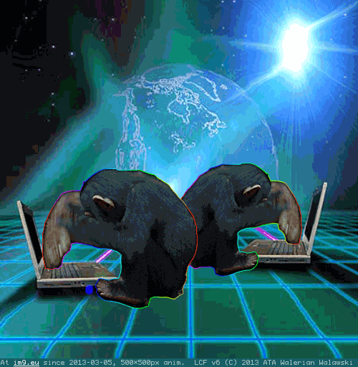
Sharing in public is harder.
But it's better.
Feeding Forward
Image: http://im9.eu/animation/publish-how-the-net-works
Notes:
Feeding Forward - We want participants to share their work with other people in the course, and with the world at large. Now to be clear: participants don't have to share. They can work completely in private, not showing anything to anybody. Sharing is and will always be their choice.
And we know, sharing in public is harder. People can see your mistakes. People can see you try things you're not comfortable with. It's hard, and it's sometimes embarrassing.
But it's better. You'll try harder. You'll think more about what you're doing. And you'll get a greater reward -- people will see what you've created and comment on it. Sometimes they will be critical, but more often they will offer support, help and praise.
But even more importantly, it helps others see the learning process, and not just the polished final result. My ambition to speak in public in French, for example, was prompted by a talk given by Doug McLeod to a national conference on learning networks. I could see that something like this can be an important step in mastering a new skill.
You know this, I don’t need to tell you this, but I’ll say it anyway: when you speak or write in your own language, in a public domain, about some topic or discipline, what you are saying is “my language encompasses that discipline.”
It’s not simply that there is a French culture, full stop. It is that French culture encompasses physics, and chemistry, and economy, and even (I’m sorry to say) political science. But more, it is to say that a part of the domains of physics and chemistry and political science are formed from, and informed by, French culture.
The philosophers know this well. Can you imagine philosophy without the contributions of Descartes and Pascal and Camus and Sartre and Derrida? Can you imagine philosophy without the influence of the language on their contributions?

Slide 39
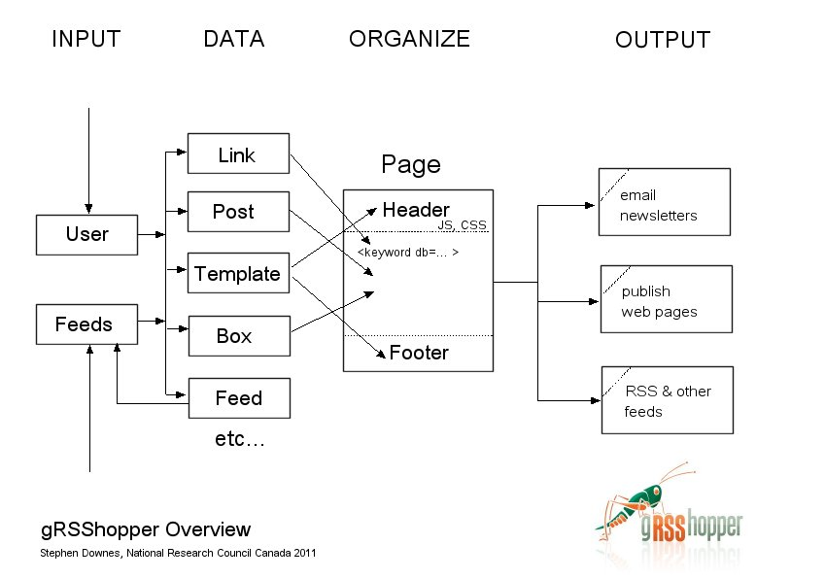
gRSShopper
http://grsshopper.downes.ca

Slide 40

5. Personal Learning Environments

Slide 41

The New Model of Work and Learning
Sharing - create linked documents, data, and objects within a distributed network
Contributing - employ social networking applications of the Web to facilitate group communication
Co-creating - work through networks that facilitate cooperative group work toward common goals
  (Dutton, p. 12)

Slide 42
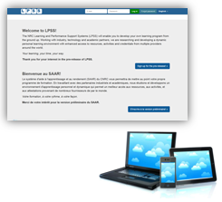
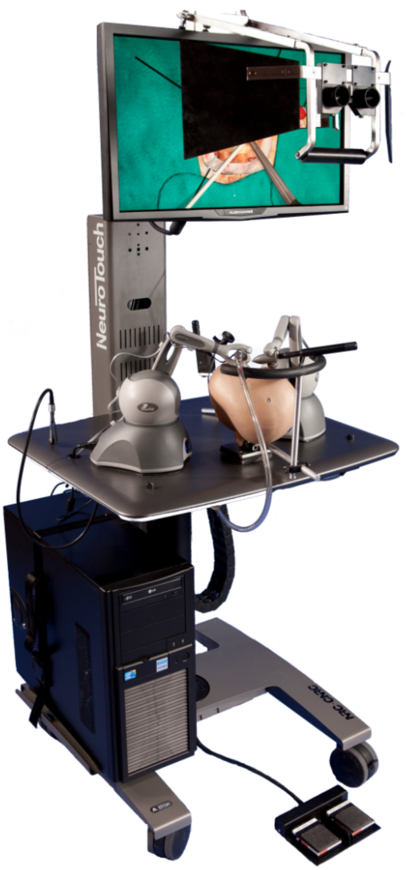
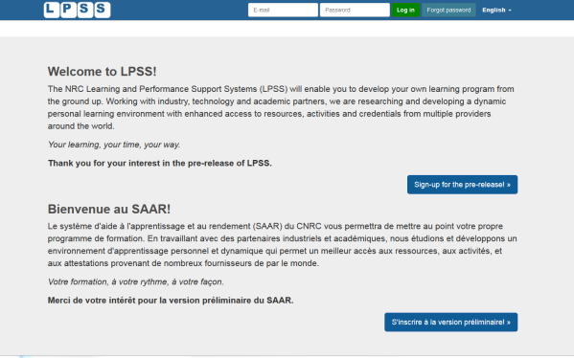

















Personal Learning – The Concept
Simulation
Learning Space
(SLS)

Slide 43
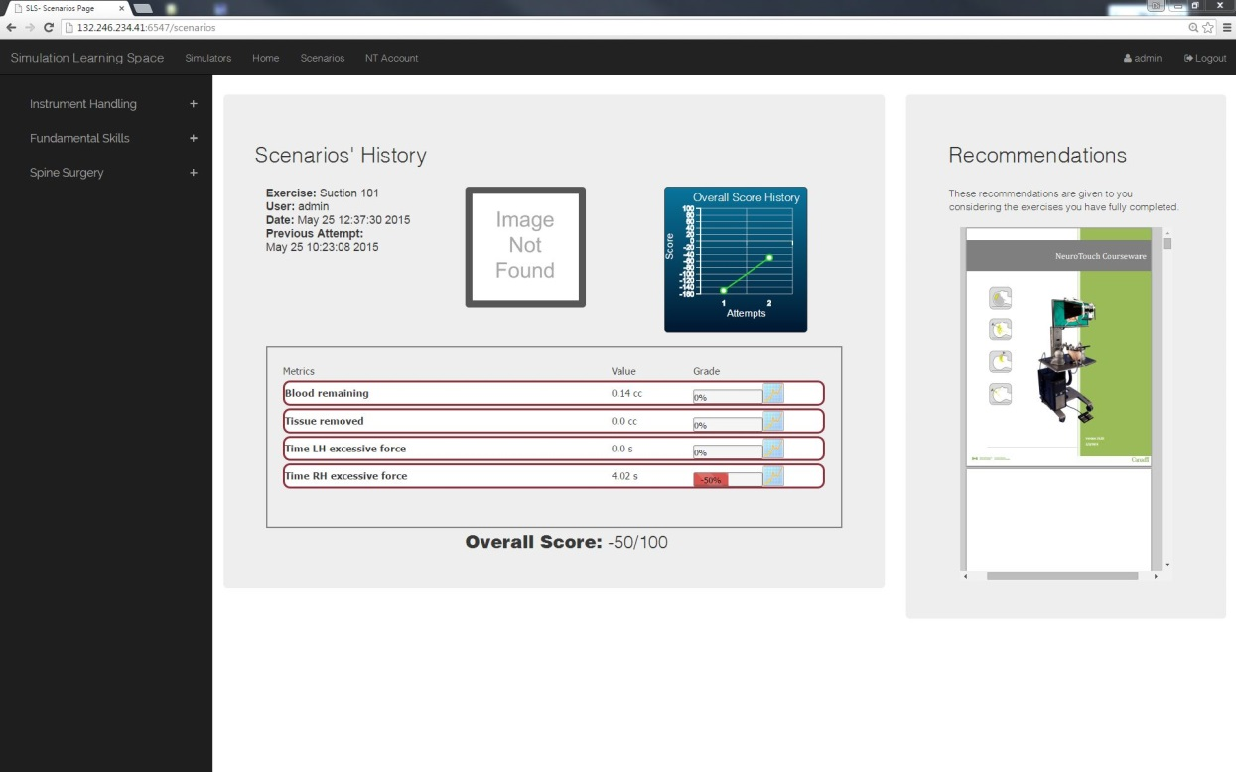
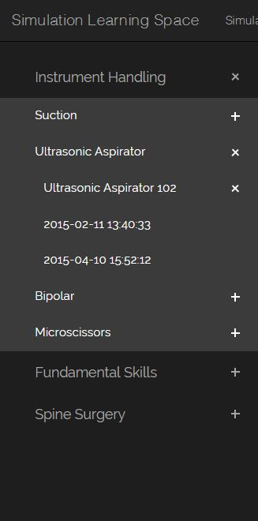
Combining Experiences
One place for all learning experiences
All performance results no matter where and when
they were carried out

Slide 44
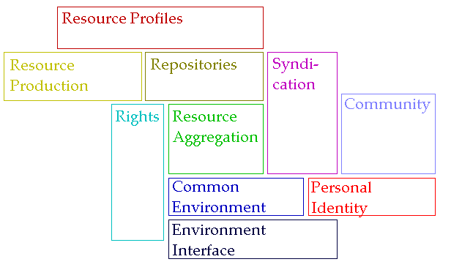
A Personal Learning Architecture
http://www.downes.ca/presentation/98

Slide 45






The Student’s Perspective
Site
A range of different resources and services

Slide 46

Personal Learning Record
The Personal Learning Record – data owned by the individual, shared only with permissions
http://halfanhour.blogspot.de/2014/12/eportfolios-and-badges-workshop-oeb14.html

Slide 47
Personal Learning Record
OERs
Portfolio, artifacts and evidence
Badges, certificates, credentials, competencies
Activity Record - LRS
PLR

Slide 48
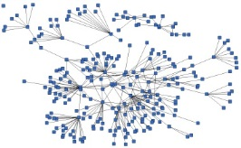
Everything is Built Around the Personal Learning Record
This is a new type of data – we call it the personal graph.
Each person has their own private personal graph.
The PLR contains all a person’s learning records, including:
certificates, badges and credentials
activity records, test results, scores
Assignments, papers, drawings, things they create
Me

Slide 49
Everything is Built Around the Personal Learning Record
Stuff Goes Out
Stuff Comes In
Learning Activities
I read and watch stuff
I play with toys
I make stuff
Things, Properties, Relations
Things I did
Stuff I make
Big stuff goes here
Me
Questions
Personal Library
Pictures
Books
Movies
Answers
Learning Analytics Services

Slide 50
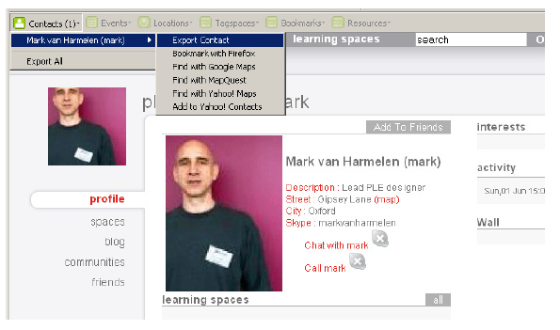
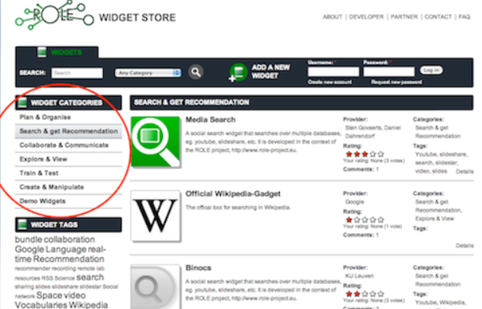
Relevant PLR Projects
Manchester PLE Project
Responsive Open Learning Environments (ROLE) http://www.role-project.eu/
Known http://withknown.com/
Learning Locker http://learninglocker.net/
Mahara https://mahara.org/
http://personalis.wikispaces.com/PLE+Projects

Slide 51
Graph Aggregation and Storage
Personal
Context
Article
Photograph
Video
Person
Author
Publisher
Organization
Job Opportunity
Competency
Cetrificate
Event
Location / Place
Time / Date
Email
RSS
OAI
Sharepoint
Facebook
Twitter
Monster
Government
Repositories
Desire2Learn
Coursera
EdX
etc
Parsing
Scraping
Analytics
etc
Storage
RELATIONS

Slide 52
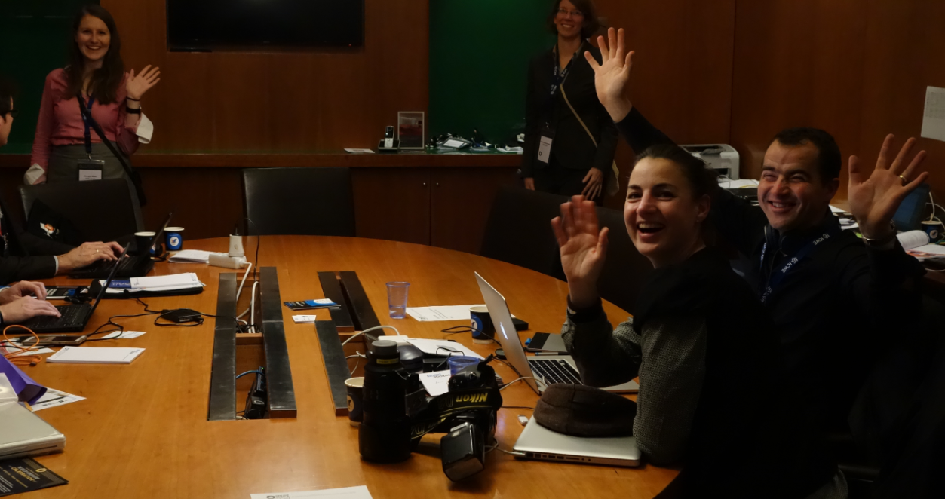
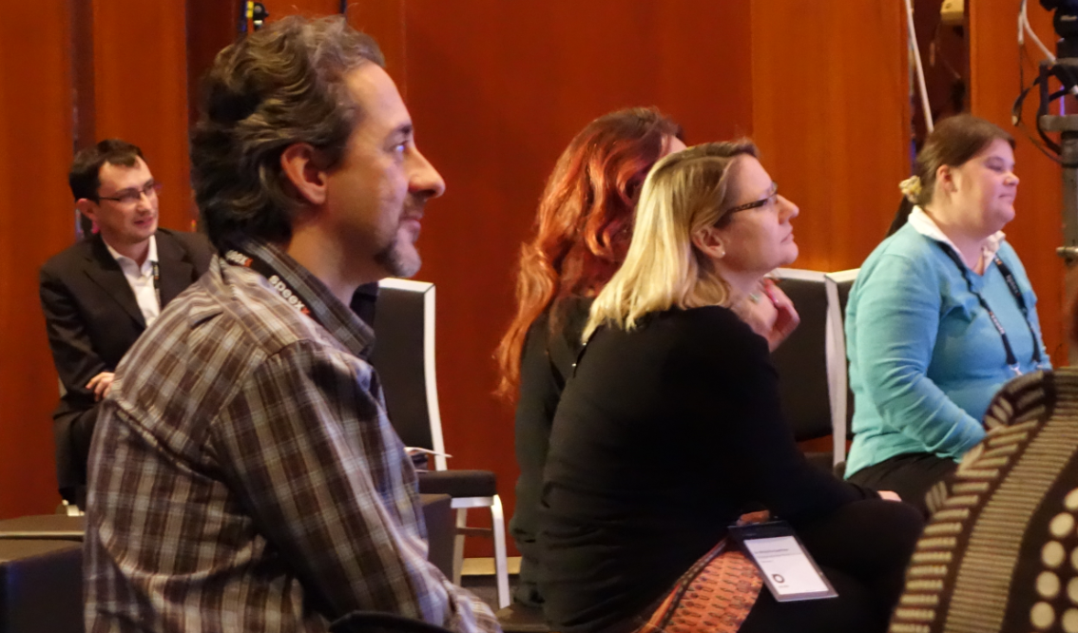
Personal Data
Third parties can provide analytics services, but they don’t get free unfettered access to the data any more (think of data like money)

Slide 53
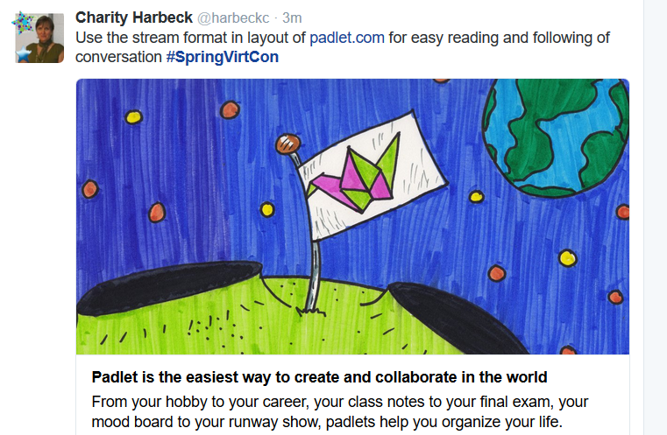
Creativity Tools
https://padlet.com/
https://www.tes.com/lessons

Slide 54


Personal Cloud
Synchronized cloud data services (including Owncloud) to support data portability

Slide 55


Distributed Network
Projection of learning services into multiple platforms

Slide 56

Connecting to real learning and workplace environments
http://www.nrc-cnrc.gc.ca/eng/rd/medical/

Slide 57

What’s Next?

Slide 58



http://www.downes.ca/presentation/233
http://makeagif.com/

Slide 59


Stephen Downes
http://www.downes.ca

Slide 60


